Slide 1
Distributed File Systems

Slide 2
Design Issues
Consider the design issues that must be resolved to build a distributed file system.
Start by considering simpler file systems and their evolutionary steps:
  Single User Single Site
  Single User Multi-Process
  Multi-User Multi-Process
  Multi-User Multi-Process Multi-System

Slide 3
Single User Single Site
For example, CP/M
Naming
  Is the name space flat or hierarchical.
  Are cycles allowed?
  How are endless loops broken.
File name structure
  none
  Fixed e.g. 8.3 format on DOS
Multiple versions supported?

Slide 4
Single User Single Site
Programming I/F
  Which file operations are defined
  How are they presented to the programmer.
  Memory mapped or read/write operations
  Is it possible to have multiple views of a file e.g. a structured file could viewed as an array of records or an array of bytes
  Are files typed?

Slide 5
Single User Single Site
Physical Storage
  How in file system abstraction mapped onto physical storage (including logical to physical sector mapping)
  Is the logical to physical block mapping media dependent.
  Large vs small blocksize (filesize and reliability play an role in determining the optimum size)
Integrity
  Consistency across power, h/w and s/w
  Cache - if write cache used how is it emptied on abnormal termination

Slide 6
Single User Single Site
Where is this type of file system found?
Is it popular?

Slide 7
Single User Single Site
Where is this type of file system found?
Is it popular?
Rare on desktop systems

Slide 8
Single User Single Site
Where is this type of file system found?
Is it popular?
Rare on desktop systems
Found on low-end embedded systems including flash media

Slide 9
Single-User Multi-Process
All of the above
Concurrency
  Locks on files
  Level of granularity e.g. Files, Blocks, Records

Slide 10
Multi-User Multi-Process
For example, Unix
Security
  How are users identified and authenticated?
  Can users be aggregated into groups?
  Capabilities vs access control lists
  At what granularity does the security mechanism operate (e.g. bytes, records, disk blocks, directories)
  What are the privileges and how do they affect operations

Slide 11
Multi*(User, Process,System)
Location
  How are files named and found across different machines
Performance
Robustness
Efficiency
Availability - Replication Strategies

Slide 12
Characteristics vs Behaviour
Do the characteristics of a file indicate the way in which it is to be used?

Slide 13
Characteristics vs Behaviour
File characteristics include:
  File Sizes, Request Rates
  Size Distribution
  Relative and Absolute frequencies of different file operations
  How often does data change
  How often do users share files for reading and writing ?

Slide 14
Characteristics vs Behaviour
Andrew Researchers (AFS) found that:
  Most files are small (<10k)
  Read operations more frequent than write operations
  Random access of files in rare
  Typical application reads in entire file
  Functional lifetime (last read - last write) is small

Slide 15
Characteristics vs Behaviour
  Most files are read and written by one user
  When users share a file one normally modifies it
  High locality of reference
  Average process uses only a few files
  Distinct file classes with different properties exist e.g. temporary files, binary files, source code

Slide 16
Distributed File System Components
File service
Directory Service

Slide 17
File Service
handles the read/write requests
opens and closed files
identifies files by a a handle of some sort (e.g. I-node number) without regard to the user-assigned path/filename.
Protection
  capability based (user has ticket)
  Access Control List (file has a list of who can access the file).
  relative advantages?

Slide 18
File Service
Two fundemental architectures
  Upload/Download Model
  Remote Access model

Slide 19
Upload/Download Model
The file is copied to the client, accessed as a local file and written back to the server if it is modified.
Open and close operations do most of the work and the read and write operations work as normal. Most of the work is performed on the client making this system very scaleable. Files may be transferred using an efficient file transfer protocol

Slide 20
Upload/Download Model
If files are large, parts of the file may be downloaded e.g. 64K
Andrew File System (AFS) is an example.

Slide 21
Remote access model
Files always reside on a server
Every read and write operation results in a remote procedure call to the client.
Systems may be Stateful or Stateless
The server does most of the work (with scalability implications). However it can have certain advantages when Unix style semantics are required.

Slide 22
Stateful Systems
The opening a file creates a connection to a remote server
Closing the file tears it down
Server keep state information between accesses

Slide 23
Stateless Systems
open and close are null operations
read/write calls are completely self-contained containing file identifier, file offset and amount of data to be read
Individual requests may be directed at different servers
Sun’s Network File System (NFS) is an example

Slide 24
Directory Service
The main responsibility of the Directory Service is to map textual pathnames onto an identifier recognised by the file system.

Slide 25
Directory Service
Operations
  Create/Delete directories
  Name and rename files
  Moves files from one directory to another
May support links, which could also span systems
  policy for removing orphaned directories across systems.
  How are they discovered and removed?

Slide 26
Directory Service
How does the global file system appear to the user?
Is there a global common system view ? (e.g.AFS)
Does each system decide where to mount remote directories ? (e.g. NFS)

Slide 27
Naming Transparency
location transparency /server1/dir1/dir2/x
  Server 1 can physically move around and the files are accessible by the same pathname but moving the directory dir1 to another server requires a change in the pathname.
location independence /dira/dir1/dir2/x
  In this case the files can be located on any server and as the server name does not appear as part of the pathname moving a directory is transparent to a user. Desirable but difficult to achieve.

Slide 28
Two-Level Naming
Symbolic names
  for use by people e.g. prog.c
  Mapping a symbolic name to a binary name may result in a list e.g. original file and its backups or clones
Binary names
  handle e.g. i-node number or uuid
  used by the system
  server id + local file ref. (see naming transparency)

Slide 29
Semantics of File Sharing
Unix Semantics
Session Semantics
Immutable Files
Transactions

Slide 30
Unix Semantics
All operations immediately visible to users
Easily achieved if one file server and no file caches
Not scaleable

Slide 31
Session Semantics
Changes visible only when file closed (except to changer)
Race condition on file close (last update wins or random)

Slide 32
Immutable files
No file updates are possible - Create/Read operations only
File replacement ok ie directory updates
Simultaneous replacements?
Simultaneous read and replacement?
Found on Digital’s VMS operating system
Mechanism for purging files essential

Slide 33
Transactions
Changes have all or nothing property

Slide 34
System Structure
Are clients and servers different?
How is file and directory service structured?
Should servers be stateful or stateless?

Slide 35
System Structure
Are clients and servers different?
  Some systems (eg NFS) run the same software on each platform allowing it to act as a client or server or both.
  Other systems (eg Lan Manager) have different client and server software
How is file and directory service structured?
  Single server for both?
  Separate servers? e.g. DOS DS and Unix DS sharing common FS

Slide 36
System Structure
Should servers be stateful or stateless?

Slide 37
System Structure
Stateless
  Is this a true distributed system?
    no shared state
  Server keeps no client-specific data between requests
  Each request is self contained - filename, offset, # bytes
  Greater fault tolerance - clients less affected by crashes
  Open/Close operations not needed
  No limits on number of open files

Slide 38
System Structure
Stateful Server
  Keeps client state between requests
  Shorter requests
  Server crash requires client involvement
  Idempotency easier e.g. on append operations
  File locking easier

Slide 39
File Caching
Essential for speed
Design Issues:
  what is the unit the cache works works with
  which eviction policy is used
Files can be stored in:
  the server's disk
  the server's memory
  the client's disk
  the client's memory

Slide 40
File Caching
Server caching
  Transparent to the client and easy to implement
  Server memory cache is generally faster than client disk cache and generally easier to implement. Hence most client caching uses client memory.

Slide 41
File Caching
Client Memory Caching
  Cache in user process address space
    only accessable to application
  Cache in kernel
    available to all users but affects kernel size
  User-level cache manager
    compatible with micro-kernel architectures

Slide 42
Replication
Increase reliability by having backups of files
Allow file access even if one server is down
Split workload over multiple servers
Need replica creation strategies
Need update protocols

Slide 43
Replication Issues
Replica Creation strategies
  Explicit copy - by system or user process, directory entry lists all copies
  Lazy copy - system makes copy in the background later
  Group replication - all writes performed in lockstep, programmer address a group
  voting or quorum based protocols e.g. Thomas/Gifford protocol

Slide 44
Gifford Quorum Based Protocol (1)
Extends Thomas’ simple majority scheme
Reads require a read quorum N_{R}
Writes require a write quorum N_{W}
Where: N is the number of replicas and
1) N_{R} + N_{W} > N
2) N_{W} > N/2

Slide 45
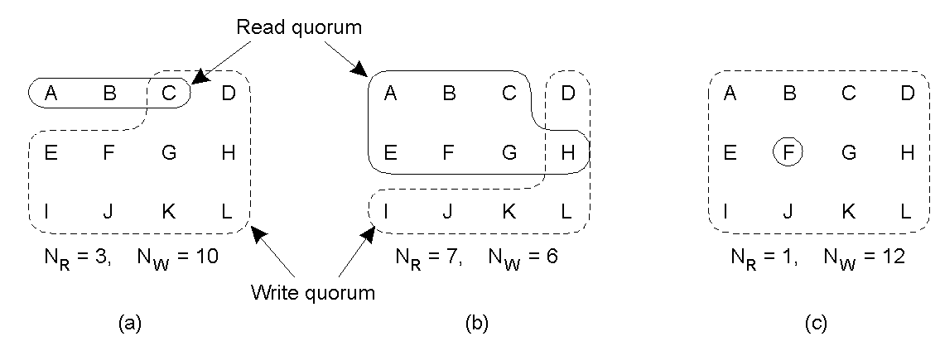
Gifford Quorum Based Protocol (2)
Three examples of the voting algorithm:
A correct choice of read and write set
A choice that may lead to write-write conflicts
A correct choice, known as ROWA (read one, write all)

Slide 46
Andrew File System (AFS)
Developed at Carnigie Mellon Uni. (CMU)
Assumes most people have their own workstation
Designed to handle 5000 - 10000 connected workstation with large number of active users
User able to use any workstation as if it were her own
No difference between client and server machines, all run a slightly modified form of the Berkeley kernel. However, the application software is very different.

Slide 47
Andrew File System (AFS)
Servers run a single program known as Vice
A piece of code (known as Venus) embodying a cache manager runs on each client (Virtue workstations)
Most work is done on the client system
The UNIX open command has been modified to copy a file (or part of a file if it is large) onto the local workstation. Almost all interaction with AFS is through the open and close system calls.

Slide 48
CODA File System
Developed at CMU in the 1990’s
Integrated with a number of Unix based operation systems including Linux
Revision of Version 2 of AFS
Supports discontinuous operation using upgraded Venus software

Slide 49
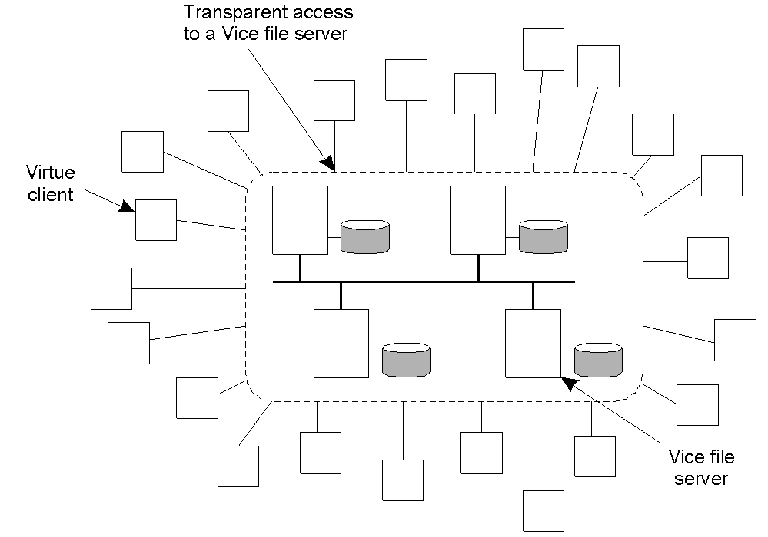
Overview of Coda (1)
The overall organization of AFS.

Slide 50
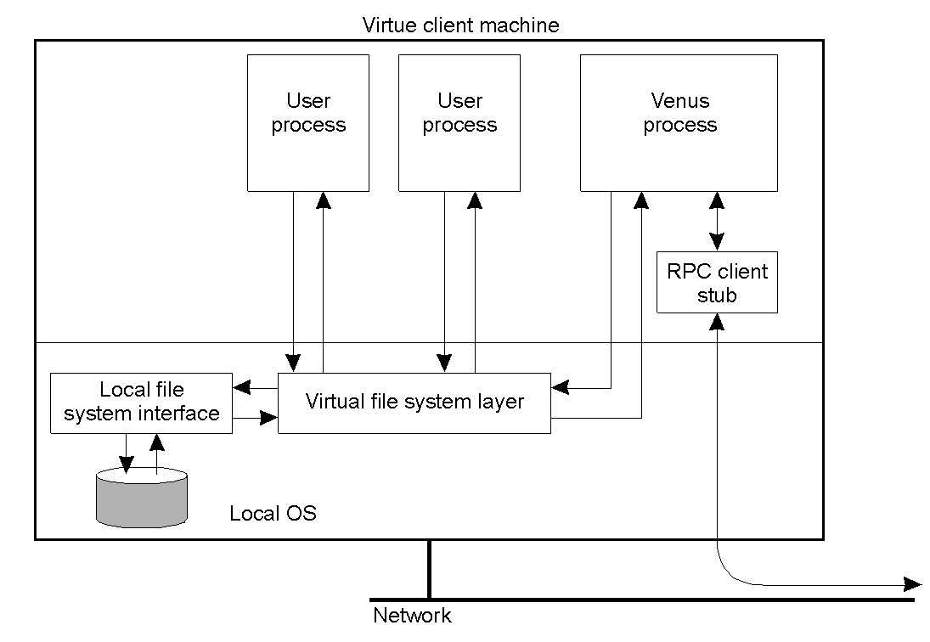
Overview of Coda (2)
The internal organization of a Virtue workstation.

Slide 51
Coda File System
Access to remote files is through a special remote directory (e.g. /afs) which appears the same on all workstations
Client workstations are not trusted, hardware encryption takes place between clients and servers
Workstations are used only for temporary files, the file cache, and paging traffic. No system or permanent files are kept there

Slide 52
Coda Communication (1)
Interprocess communication is via the remote procedure call protocol RPC2
A separate thread is created for every request to the server
The client blocks but the server sends back regular status messages and requests may take a long time to complete

Slide 53
Coda Communication (2)
A side-effect supports an application level protocol
For example, a continuous stream video from server to client
Connection setup is done as a side effect of a remote procedure call
RPC2 also supports multi-casting to invalidate copies of a file

Slide 54
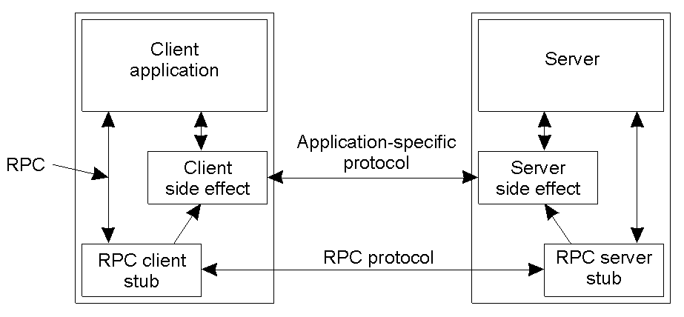
Coda Communication (3)

Slide 55
Coda Name Space (1)
CODA uses a naming scheme similar to Unix
For administrative reasons files are groups into volumes which are subtrees in the shared namespace
Volumes are used for replication and backup

Slide 56
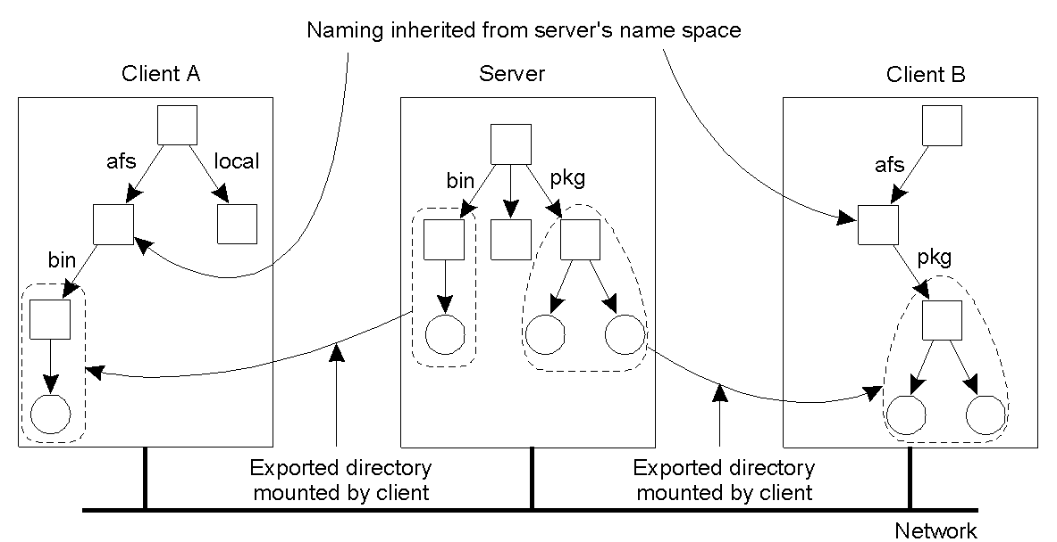
Coda name Space (2)
Clients in Coda have access to a single shared name space.

Slide 57
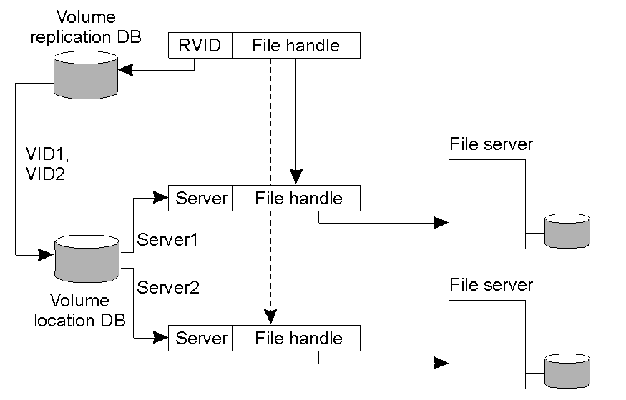
File Identifiers
The implementation and resolution of a Coda file identifier.

Slide 58
Andrew File System (AFS)
Workstations are grouped into administrative domains known as cells
If requested to Vice will keep track of the copies of file it gave out and inform clients when the file changes at the server
File locking is supported, with a timeout - typically 30 mins
A volume is a collection of directories that are managed together, e.g. a user's subtree, or a directory of binary file.

Slide 59
AFS Implementation
Internally AFS uses two level naming, directory lookups of path names return fids (file identifiers).
All Vice servers maintain a database that maps volumes to locations. The database needs to be updated when a volume migrates.
Volume migration is atomic.
Periodically (eg daily) a read-only copy of each volume is made this is then copied to tape for backup.

Slide 60
AFS Implementation
File open steps enacted by Venus:
  Application makes open call which is caught by Venus
  If pathname does not start with /cmu file treated as a normal local file
  Otherwise pathname is parsed and lookup component by component until a fid is found
  Venus uses fid to check cache

Slide 61
AFS Implementation
  if file is on cache and valid then cached file is used
  if file is on cache and invalid then vice server is consulted to see if file has changed since download (e.g. reboot may invalidate cached version). If file unchanged cached version used.
  if file is not on cache or cached but genuinely invalid the file is loaded into the local /cache directory

Slide 62
AFS Implementation
Venus also maintains a cache that maps pathnames to fids. This enables the pathname lookup process to be skipped. If this fid cache is out of date the different unique number will prevent its reuse.
If the local disk cache is full Venus will the least recently used files.
Vice runs as a single multithreaded process on each server. Each thread handles a separate request.
Vice and Venus communicate using a RPC built directly on top of IP

Slide 63
Lessons learned from AFS
Workstations have cycles to burn (do little as possible on server)
Cache whenever possible
Exploit usage properties (eg treat temporary files in a certain way)
Minimize system wide knowledge
Trust the fewest possible entities
Batch work when ever possible (send 50K file in one go, rather than 50x1k)

